Slide 1

HADOOP
GROUP 1
AARADHY
ANKITA
DHAVAL

Slide 2

Definition
Hadoop is an open source, Java-based programming framework designed to deliver a distributed file system (HDFS) that supports the processing and storage of extremely large data sets in a distributed computing environment.
It is part of the Apache project sponsored by the Apache Software Foundation.

Slide 3
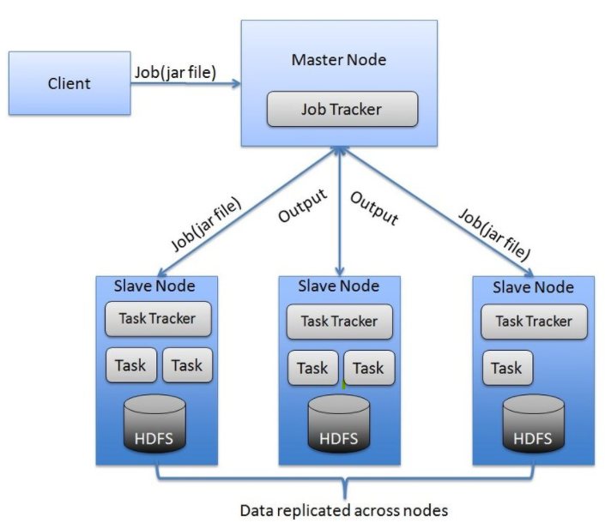
Architecture
Hadoop Architecture Consist of
Master Node
Slave Node
Map Reduce
HDFS
Job Tracker

Slide 4
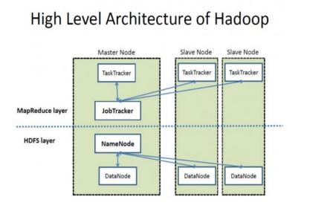

Slide 5
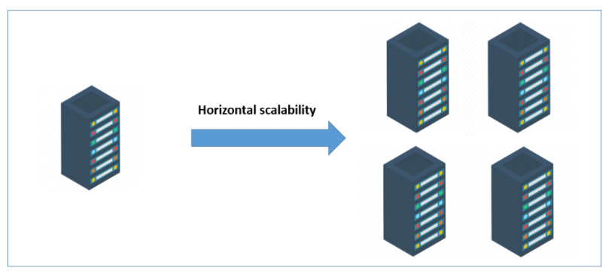
Scalability
HADOOPONOMICS
Hadoop has Horizontal/linear scaling.
That is adding more machine to existing pool
Linear increase in data Size
Linear increase on Compute Resources

Slide 6
Security
Three main security features :
Authentication
Default – non secure mode
Configured – secure mode
Service Level Authorization
It is the initial authorization mechanism to ensure clients connecting to a particular Hadoop service have the necessary, pre-configured, permissions and are authorized to access the given service.

Slide 7
Authentication of Web Consoles By default, Hadoop HTTP web-consoles (JobTracker, NameNode, TaskTrackers and DataNodes) allow access without any form of authentication. Similarly to Hadoop RPC, Hadoop HTTP web-consoles can be configured to require Kerberos authentication using HTTP SPNEGO protocol (supported by browsers like Firefox and Internet Explorer). In addition, Hadoop HTTP web-consoles support the equivalent of Hadoop's Pseudo/Simple authentication. If this option is enabled, user must specify their user name in the first browser interaction using the user.name query string parameter. Data Encryption on RPC • The data transferred between hadoop services and clients. • Setting hadoop.rpc.protection to "privacy" in the core-site.xml activate data encryption. Data Encryption on Block data transfer • You need to set dfs.encrypt.data.transfer to "true" in the hdfssite.xml in order to activate data encryption for data transfer protocol of DataNode. Data Encryption on HTTP • Data transfer between Web-console and clients are protected by using SSL(HTTPS).

Slide 8
Manageability
Hadoop is a popular tool used for organizing the racks and racks of servers
These mechanism can be much more powerful than the old single machine, but they are far from being as polished as the old database servers.
Although SQL may be complicated, writing the JOIN query for the SQL databases was often much simpler than gathering information from dozens of machines and compiling it into one coherent answer.
Hadoop jobs are written in Java, and that requires another level of sophistication. The tools for tackling big data are just beginning to package this distributed computing power in a way that's a bit easier to use.
Managing big data can be daunting, so you should seek a distribution for Hadoop that lowers the administrative burden. Manageability, including multi-tenancy, is key to ensuring production success and continued growth.

Slide 9
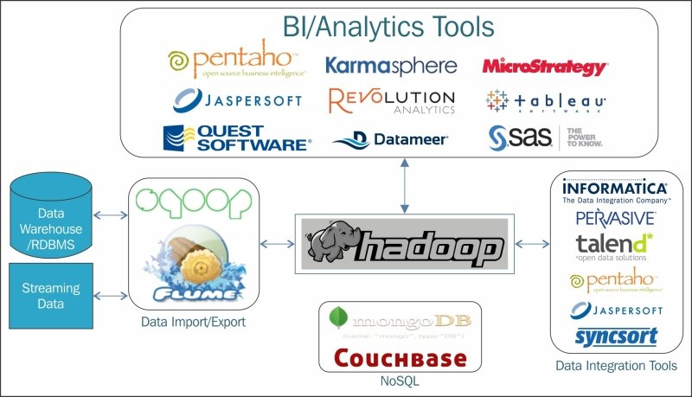
Hadoop Integration with other systems

Slide 10
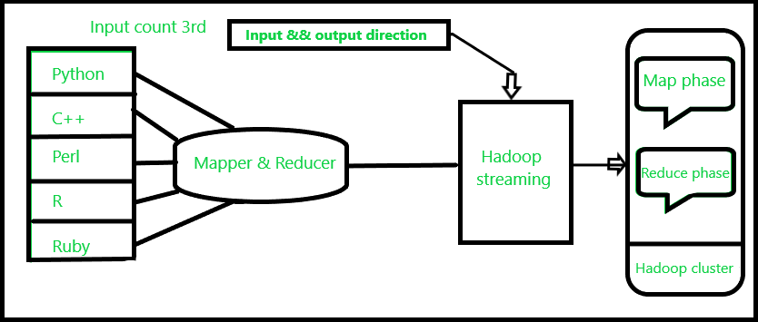
Supported Languages
Hadoop is mainly Java compatible. But Hadoop streaming is a Hadoop utility for running the Hadoop MapReduce job with executable scripts such as Mapper and Reducer.
The script is available as part of the R package on CRAN.
The main benefit of the Hadoop streaming is to allow the execution of the Java, as well as non-Java based programmed MapReduce jobs over Hadoop clusters. The Hadoop streaming supports various languages like Perl, Python, PHP, R, and C++, and other programming languages efficiently.

Slide 11
Benefits
Highly Available- In Hadoop 2.x, HDFS architecture has a single active NameNode and a single Standby NameNode, so if a NameNode goes down then we have standby NameNode to count on. But Hadoop 3.0 supports multiple standby NameNode making the system even more highly available as it can continue functioning in case if two or more NameNodes crashes.
Low Network Traffic- Each job submitted by the user is split into a number of independent sub-tasks and these sub-tasks are assigned to the data nodes thereby moving a small amount of code to data rather than moving huge data to code which leads to low network traffic.
Compatibility- Most of the emerging technology of Big Data is compatible with Hadoop like Spark, Flink etc. They have got processing engines which work over Hadoop as a backend i.e. We use Hadoop as data storage platforms for them.

Slide 12
Pitfalls
Processing Overhead- In Hadoop, the data is read from the disk and written to the disk which makes read/write operations very expensive when we are dealing with tera and petabytes of data. Hadoop cannot do in-memory calculations hence it incurs processing overhead.
Supports Only Batch Processing- At the core, Hadoop has a batch processing engine which is not efficient in stream processing. It cannot produce output in real-time with low latency. It only works on data which we collect and store in a file in advance before processing.
Iterative Processing- Hadoop cannot do iterative processing by itself. Machine learning or iterative processing has a cyclic data flow whereas Hadoop has data flowing in a chain of stages where output on one stage becomes the input of another stage.

